Slide 1
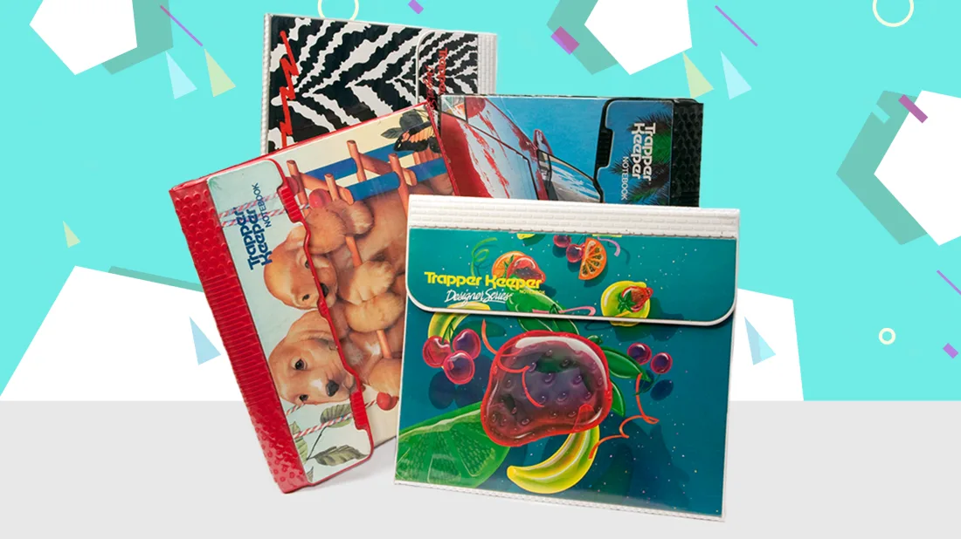
Homework Helper
The Modern Trapper Keeper

Slide 2
This “new norm” remote learning environment can be challenging and… boring. We’ve created an app to help your kids stay on track with homework and enjoy it!

Slide 3
Concept
Description: Created for grades K-12. Homework Helper is an online platform to keep track of assignments. This application also assists students with their homework in the form of a calculator, grammar bot, and spell checker. We’ve added a place for artwork as well!
Motivation: Due to Covid-19, students have had to move to remote online learning. We’ve heard from friends and family that this switch to online learning has been difficult for some kids and we wanted to help. Inspired by the old school Trapper Keepers, we’ve created an electronic version that is visually appealing and user friendly.
User story:
AS A student
I WANT an application to help me with and keep track of my homework
SO THAT I can complete my homework assignments more easily from home.

Slide 4
Process
Technologies used:
Primary Roles: Vince: back-end Rebecca: overlap between both Joy: front-end
**all team members contributed to pieces of both front and back-end development
Challenges: Getting acquainted with Github. Researching and learning new APIs.
Successes: Team collaboration. Additional experience with APIs, CSS frameworks.
Visual Studio Code | HTML | CSS | Materialize.css | NES.css
Git | JavaScript | jQuery | Twin Word | GrammarBot
GitHub |  | AJAX | Slider.js

Slide 5
What you’ve all been waiting for…

Slide 6
Directions for Future Development
Integrate with school syllabi and automatically display assignments and due dates.
Saving and submitting work through the app.
Full 12-month calendar access.
Enhancements to learning for high school students. (i.e. enhanced calculator functions, science app)
Score keeper – the more you use the app, the higher your score. Create an API to tie in your actual grade. Teachers can use this to help track which students are staying engaged and on track with assignments.

Slide 7
Links
https://vscacchitti.github.io/HomeworkHelper/
https://github.com/VScacchitti/HomeworkHelper

